Slide 1
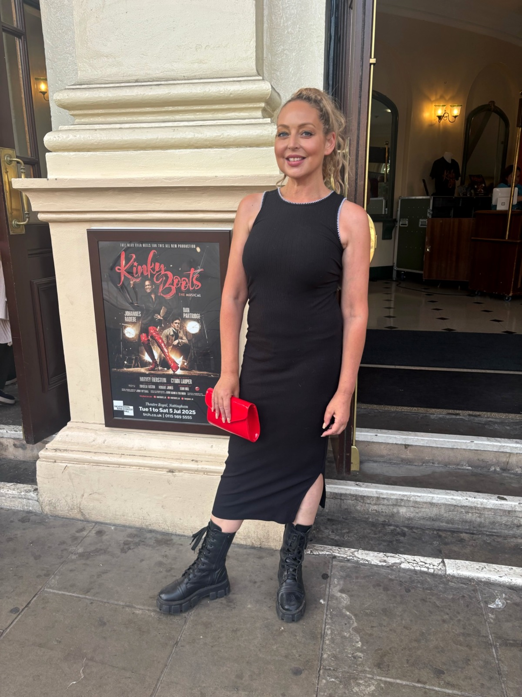
MEDIA PACK
Tanya
Louise
Lifestyle creator • Blogger • Presenter
Real life, style, home, food, theatre, events and coastal escapes - created with personality, warmth and trust.
NOTTINGHAM + LINCOLNSHIRE COAST
@realtanyalouise • tanyalouise.net

Slide 2
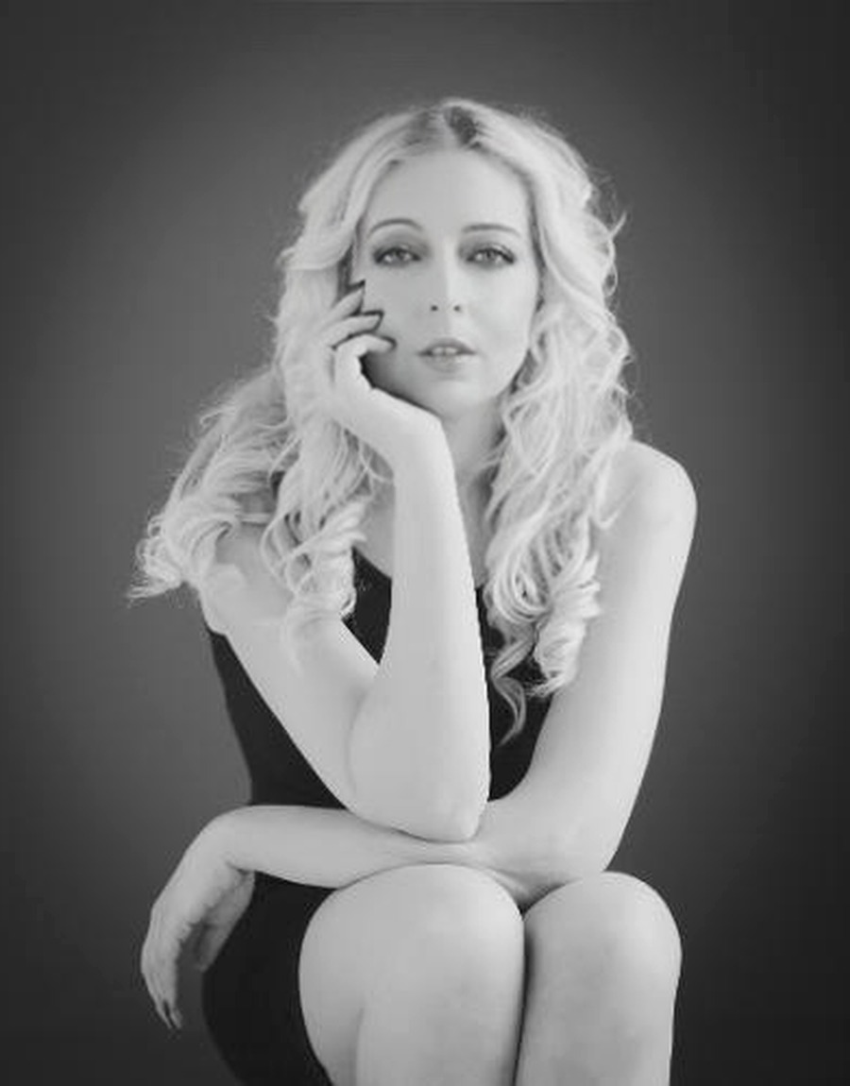
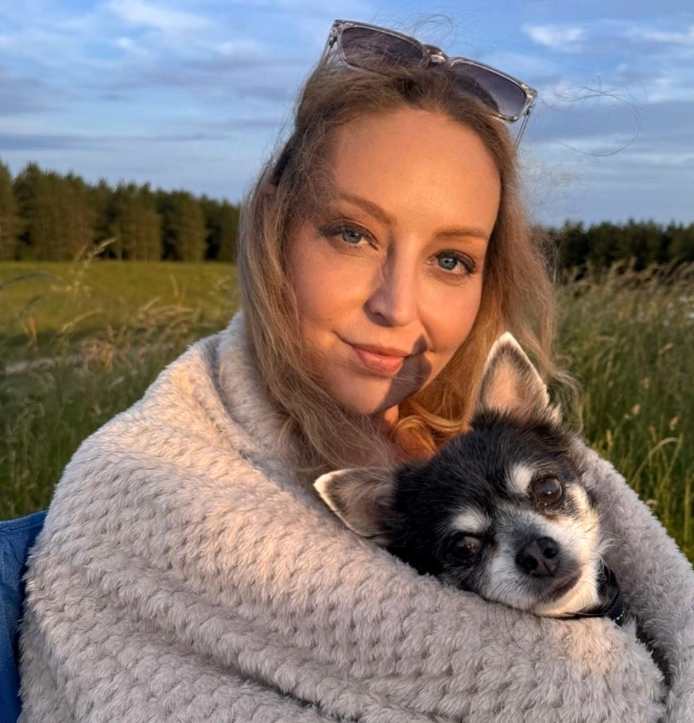
ABOUT
A relatable lifestyle voice with a polished edge.
Tanya Louise is a Nottingham-based lifestyle creator and blogger sharing personality-led content across everyday style, home, food, theatre, events, dog-friendly days out and coastal life. Her content is conversational, useful and visually strong - designed to feel like a recommendation from someone you trust, rather than a scripted advert.
Content that feels natural, useful and human.
Alongside her own platforms, Tanya has experience in social media management, blogging, live events, presenting, podcasting and community content. That gives brand partners a creator who understands both the audience-facing story and what the campaign needs to achieve.
CORE THEMES
LIFE AFTER 50
HOME + INTERIORS
THEATRE + EVENTS
FOOD + VENUES
COASTAL LIFE
DOG-FRIENDLY

Slide 3
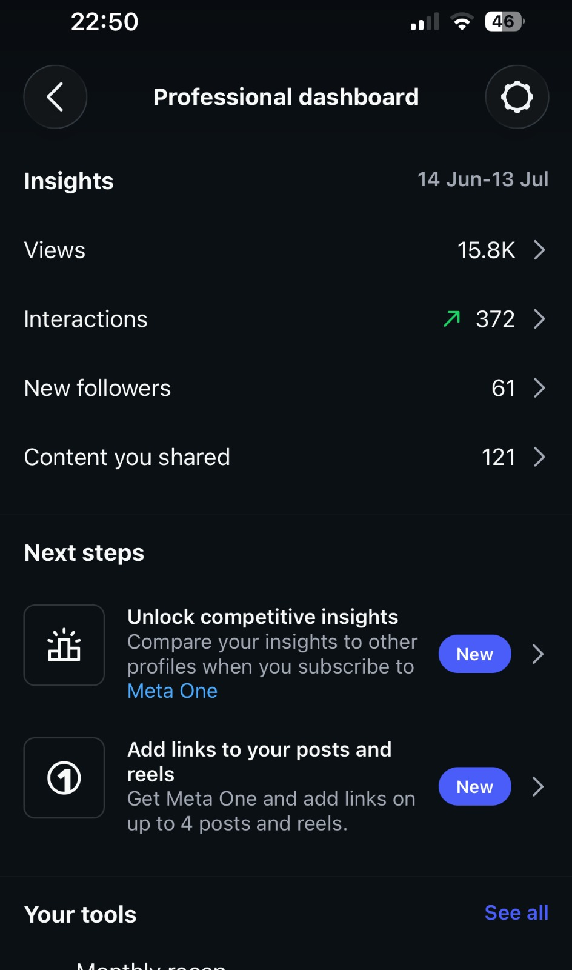
AUDIENCE + PERFORMANCE
Numbers with context.
A snapshot of recent Instagram activity, alongside standout historical performance.
15.8K
372
+61
views
interactions
new followers
121
1M+
pieces of content shared
views on a standout Reel
Recent Instagram insights: 14 June - 13 July 2026
Instagram Professional Dashboard

Slide 4
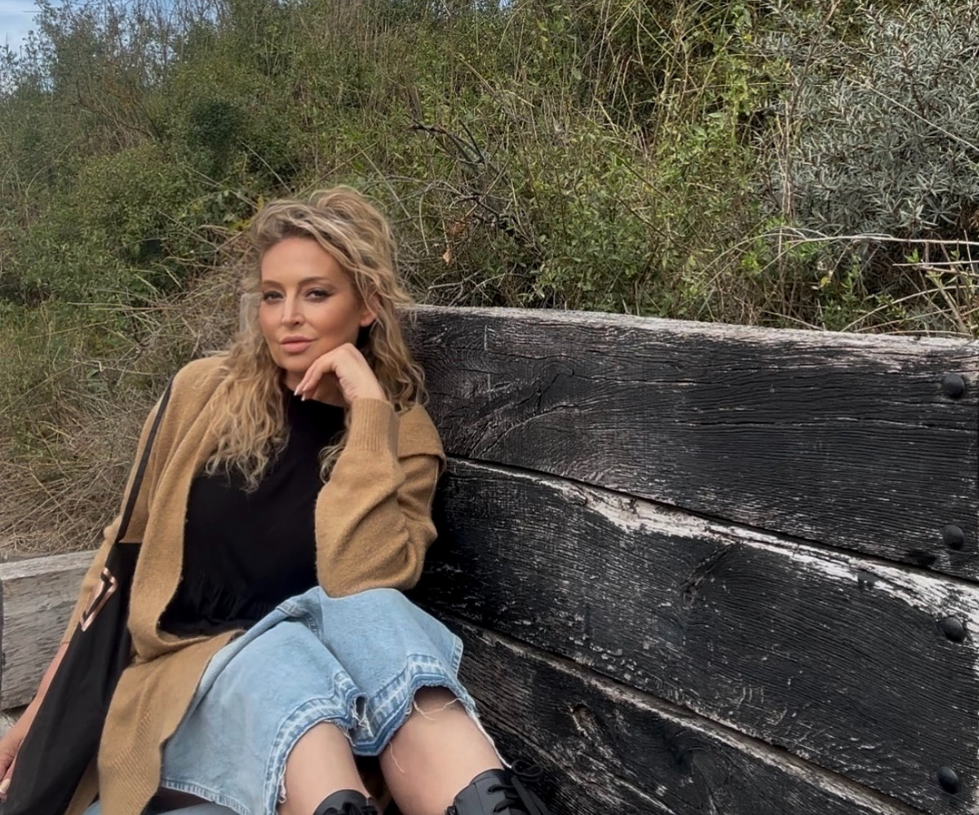
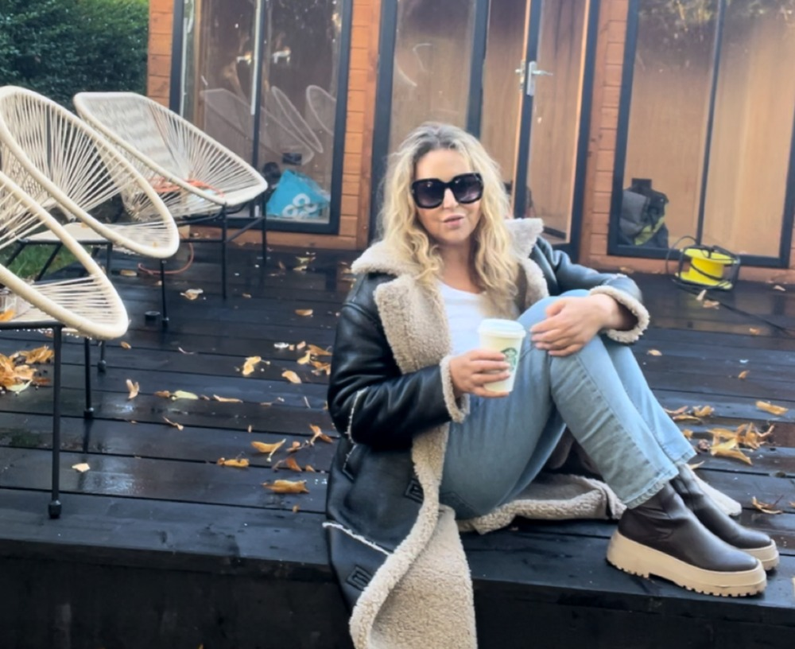
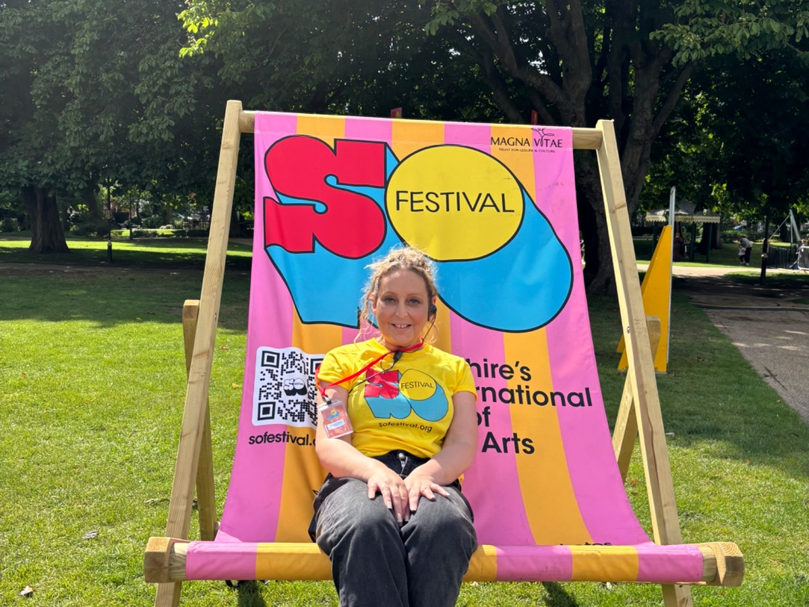
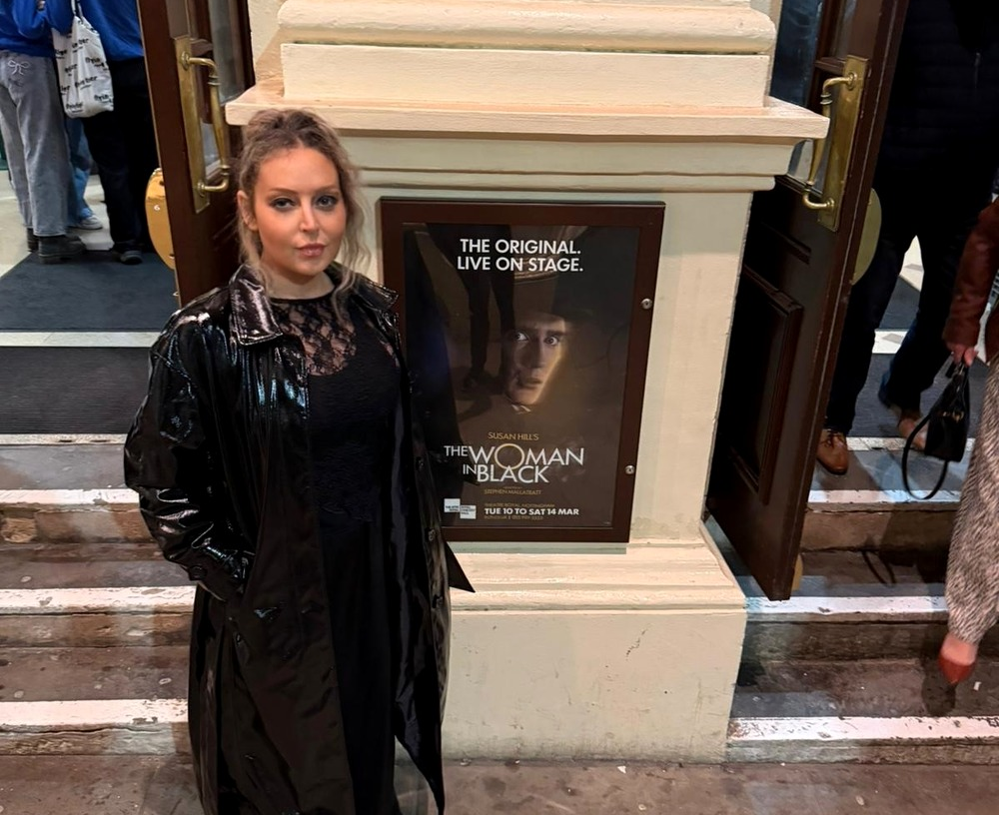
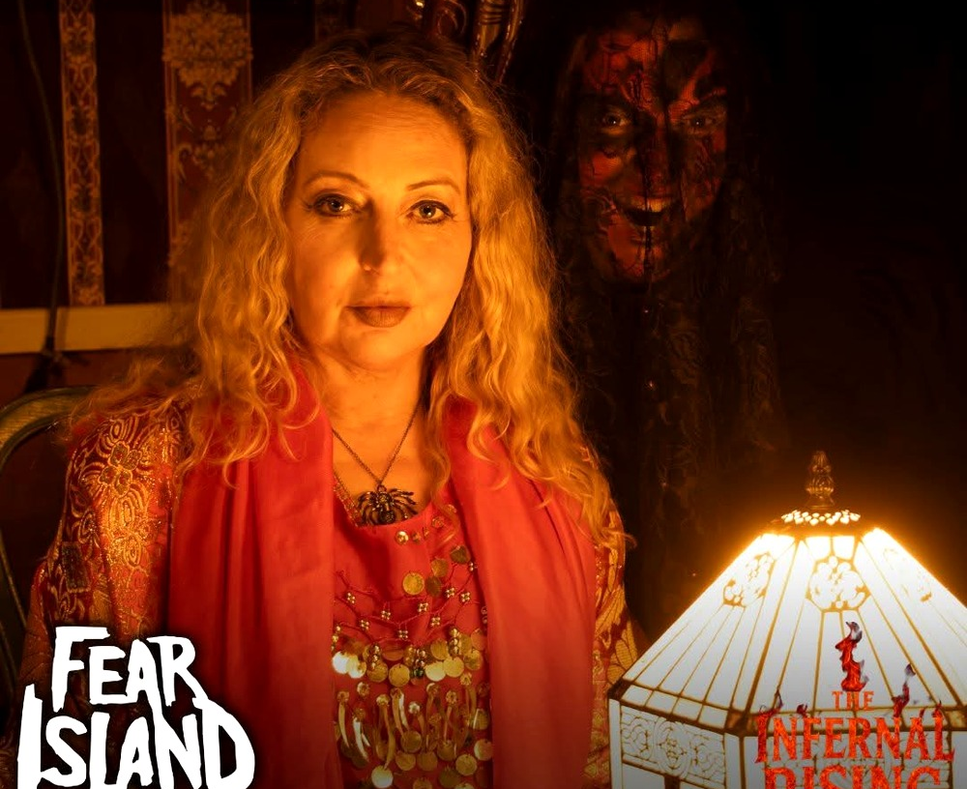
CONTENT PILLARS
Where Tanya naturally fits.
The strongest partnerships sit inside stories her audience already expects to see.
Lifestyle + real life
Home + interiors
Food, theatre + days out
Over-50 life, personal style, everyday confidence and honest recommendations.
Scandi-industrial updates, practical finds, garden projects and renovations.
Restaurants, cultural events, press nights, attractions and coastal experiences.

Slide 5
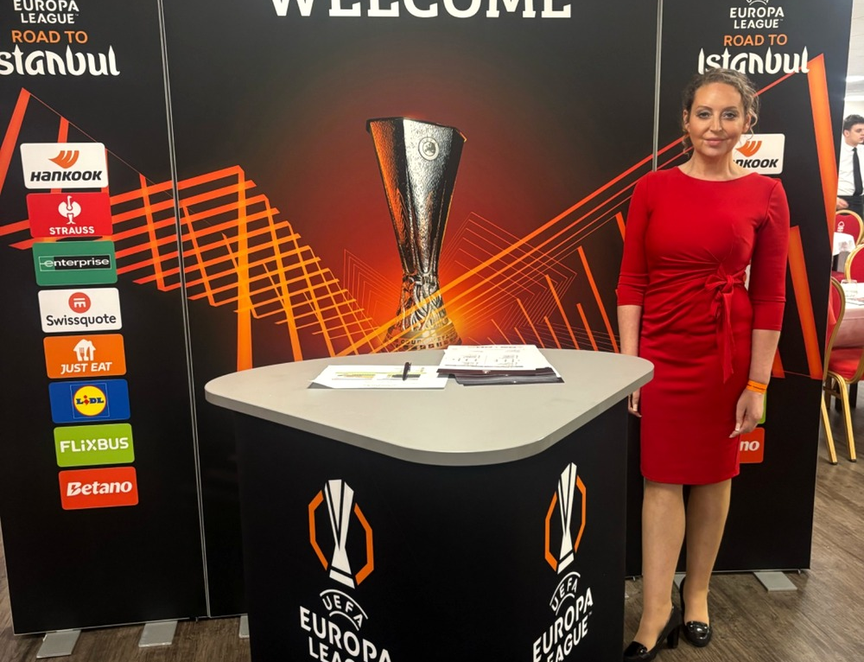
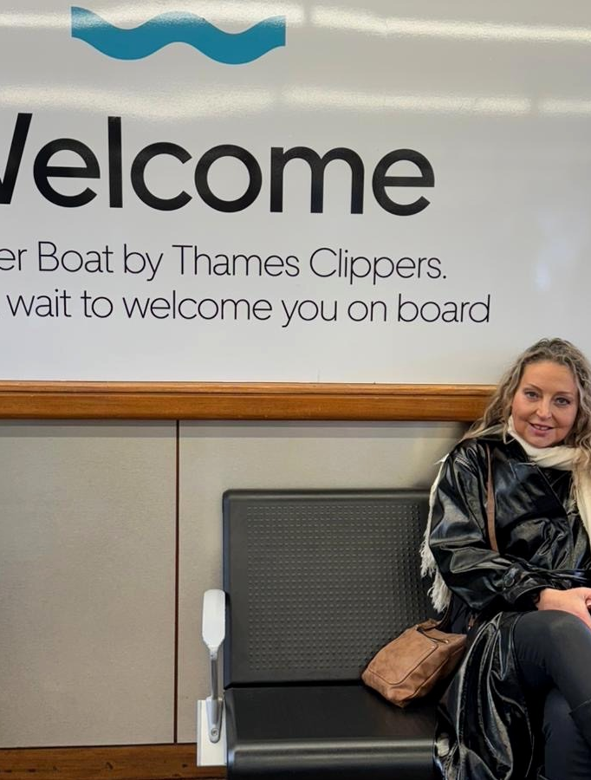
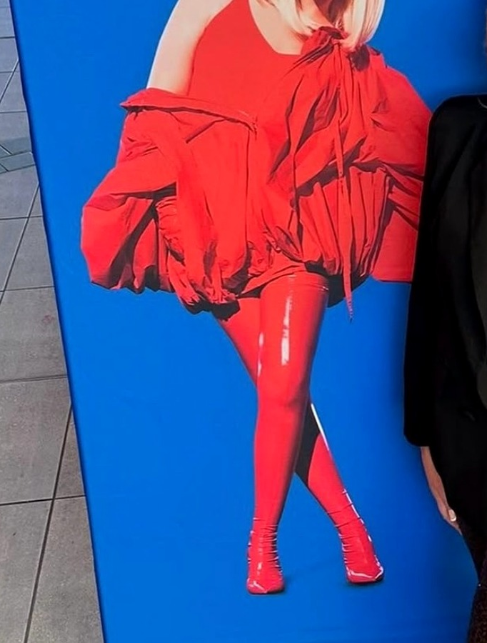
COLLABORATIONS
Ways we can work together.
Flexible deliverables can be built around one-off campaigns, launches, experiences or longer-term partnerships.
Social content
Editorial + events
Instagram Reels, Stories, feed posts, carousels, talking-to-camera content and voiceovers.
Blog features, venue reviews, theatre and event coverage, hosted experiences and press trips.
UGC + brand assets
Campaign support
Short-form video, product demos, testimonials and lifestyle photography for use on brand channels.
Social media insight, content planning and a creator perspective that understands the wider campaign.
From live events to lifestyle experiences.

Slide 6
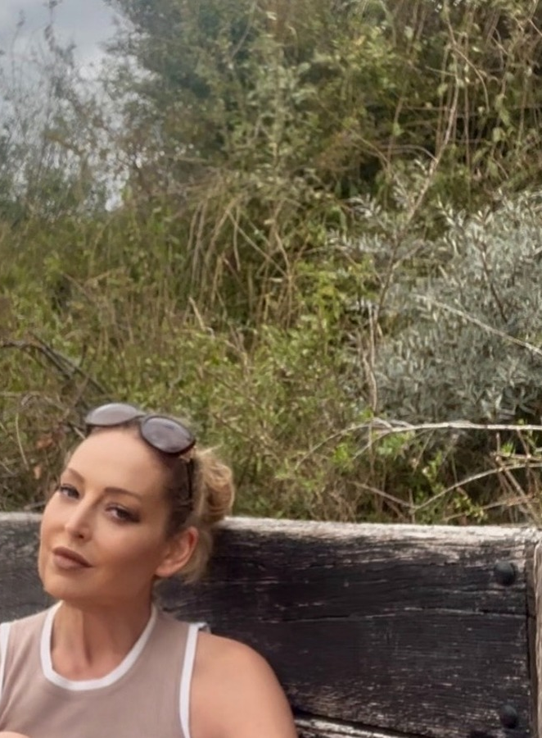
LET'S WORK TOGETHER
Tell me what you're planning.
Partnerships are tailored to the campaign. Rates and packages are available on request.
@realtanyalouise
tanyalouise.net
Nottingham • Lincolnshire Coast • UK

